Slide 1
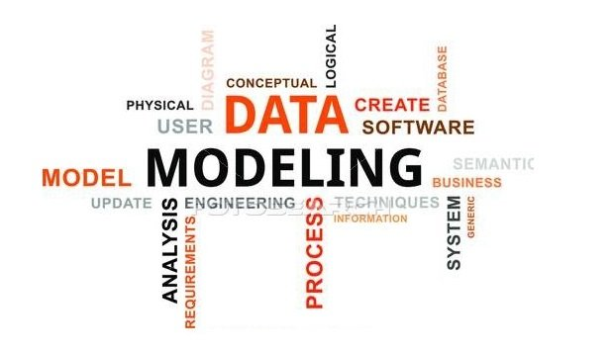
Data Modeling - Gaurav Rajput

Slide 2



Key Take Away from this session
Understand the Concept of Relational DB Modeling
The Data Modeling Process
The entity-relationship model (ER Diagram)

Slide 3

What is Data modeling
Data modeling in software engineering is the process of creating a data model for an information system by applying certain formal techniques.
Data modeling is the analysis of data objects and their relationships to other data objects.
Data modeling is often the first step in database design and object-oriented programming ,as the designers first create a conceptual model of how data items relate to each other.
Data modeling involves a progression from conceptual model to logical model to physical schema.

Slide 4

Analogy of Data Modeling process
Constructing a Guest House ( Build a Database (OLTP/OLAP))
Get an Architect : ( Get a Data Modeller )
State the Building Requirement : (State the Business requirements)
Architect would come up with a Layout Plan : ( A Data modeller comes up with a Data model )
Finally Civil Engineers would have it constructed : ( A DBA/Developer creates a relational model in the database )

Slide 5


Why Data Modeling

Slide 6
How is Data Modeling Done
Top down Approach – Scratch from BRD
Bottom Up Approach – Existing systems
Data models for an OLTP : Normalized using Normalization Technique
Data models for an OLAP : De-Normalized
Data models helps Functional Teams and Technical Teams in designing the database
Functional teams :- Business Analysts, Business Managers, Subject Matter Experts, End users etc
Technical Teams :- Database Developers or Database Administrators

Slide 7
What is a Data model ?
A data model in software engineering is an abstract model that describes how data are represented and accessed. Data models formally define data elements and relationships among data elements for a domain of interest.
A data model is a representation of:
The reality.
things (or entities or objects) of importance to a business
how the things relate to each other
A data model is a formal way to represent the business rules
A diagram can be used as a blueprint for the construction of new software or for re-engineering a legacy application.
A database model shows the logical structure of a database, including the relationships and constraints that determine how data can be stored and accessed

Slide 8
Example Types Of Data Model
Hierarchical database model
Network model
Object-oriented database model
Entity-relationship model
Object-relational model

Slide 9
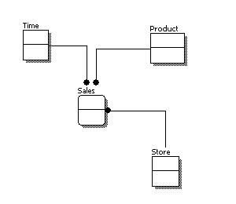
Data Modeling Process
Conceptual : A conceptual data model identifies the highest-level relationships between the different entities.
Includes the important entities and the relationships among them.
No attribute is specified.
No primary key is specified.

Slide 10
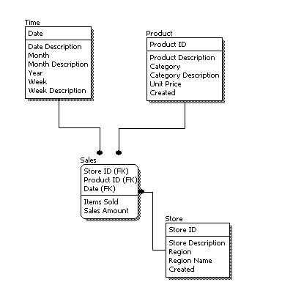
Data Modeling Process
Logical : A logical data model describes the data in as much detail as possible, without regard to how they will be physical implemented in the database
Features of a logical data model include:
Includes all entities and relationships among them.
All attributes for each entity are specified.
The primary key for each entity is specified.
Foreign keys (keys identifying the relationship between different entities) are specified.
Normalization occurs at this level.

Slide 11
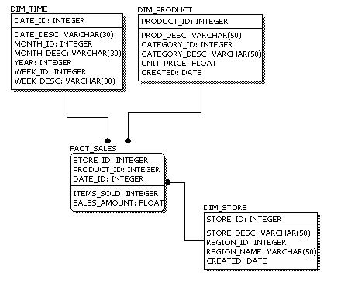
Data Modeling Process
Physical : Physical data model represents how the model will be built in the database
Features of a physical data model include
Specification all tables and columns.
Foreign keys are used to identify relationships between tables.
Denormalization may occur based on user requirements.
Physical considerations may cause the physical data model to be quite different from the logical data model.
Physical data model will be different for different RDBMS. For example, data type for a column may be different between MySQL and SQL Server.

Slide 12
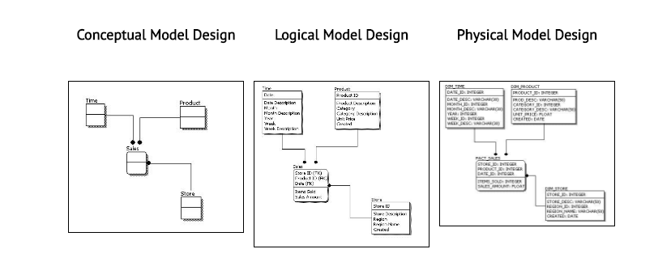
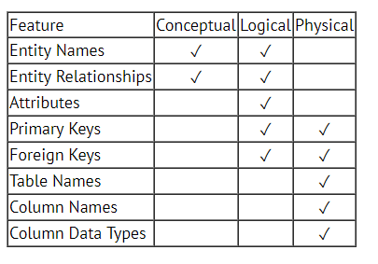
Comparing the Models

Slide 13
Available Tools in the Market
Tools Available ?
Xcase -- Resolution Ltd
Erwin -- Computer Associates
Rational Rose -- IBM Corporation
Oracle Designer - Oracle Corporation
Power Designer -- Sybase Corporation
Toad

Slide 14
What is an Entity Relationship Diagram (ERD)
ER-modeling is a data modeling technique used in software engineering to produce a conceptual data model of a information system.
Diagrams created using this ER-modeling technique are called Entity-Relationship Diagrams, or ER diagrams or ERDs.
There are three basic elements in ER-Diagrams:
Entities are the "things" for which we want to store information. An entity is a person, place, thing or event.
Attributes are the data we want to collect for an entitiy.
Relationships describe the relations between the entities.

Slide 15
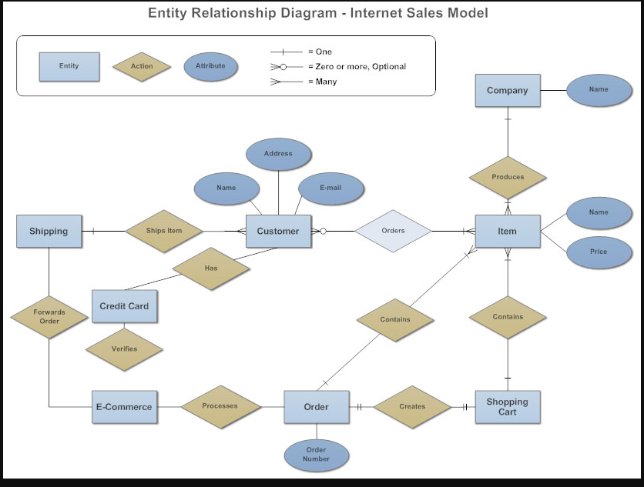
Trailer

Slide 16
Uses of entity relationship diagrams
Database design: ER diagrams are used to model and design relational databases, in terms of logic and business rules (in a logical data model) and in terms of the specific technology to be implemented (in a physical data model.)
Database troubleshooting: ER diagrams are used to analyse existing databases to find and resolve problems in logic or deployment. Drawing the diagram should reveal where it’s going wrong.
Business process re-engineering (BPR): ER diagrams help in analysing databases used in business process re-engineering and in modeling a new database setup.
Education: Databases are today’s method of storing relational information for educational purposes and later retrieval, so ER Diagrams can be valuable in planning those data structures.
Research: Since so much research focuses on structured data, ER diagrams can play a key role in setting up useful databases to analyse the data.

Slide 17

The components and features of an ER diagram
Entity : A definable thing—such as a person, object, concept or event—that can have data stored about it. Think of entities as nouns. Examples: a customer, student, car or product. Typically shown as a rectangle.
Entity type: A group of definable things, such as students or athletes, whereas the entity would be the specific student or athlete. Other examples: customers, cars or products.
Entity set: Same as an entity type, but defined at a particular point in time, such as students enrolled in a class on the first day. Other examples: Customers who purchased last month, cars currently registered in Florida.
Entity categories: Entities are categorized as strong, weak or associative. A strong entity can be defined solely by its own attributes, while a weak entity cannot. An associative entity associates entities (or elements) within an entity set.

Slide 18
The components and features of an ER diagram
Entity keys: Refers to an attribute that uniquely defines an entity in an entity set. Entity keys can be super, candidate or primary.
Super key: A set of attributes (one or more) that together define an entity in an entity set.
Candidate key: A minimal super key, meaning it has the least possible number of attributes to still be a super key. An entity set may have more than one candidate key.
Primary key: A candidate key chosen by the database designer to uniquely identify the entity set.
Foreign key: Identifies the relationship between entities.

Slide 19



The components and features of an ER diagram
Attribute :- A property or characteristic of an entity.
Simple : Means the attribute value is atomic and can’t be further divided, such as a phone number.
Composite: Sub-attributes spring from an attribute.
Derived: Attributed is calculated or otherwise derived from another attribute, such as age from a birthdate.
Multi-value: More than one attribute value is denoted, such as multiple phone numbers for a person.
Relationship :-How entities act upon each other or are associated with each other.
A relationship type is a meaningful association between entity types
A relationship is an association of entities where the association includes one entity from each participating entity type.
Relationship types are represented on the ER diagram by a series of lines.
As always, there are many notations in use today...
In the original Chen notation, the relationship is placed inside a diamond, e.g. managers manage employees:

Slide 20

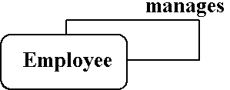
The components and features of an ER diagram
Degree of a Relationship
The number of participating entities in a relationship is known as the degree of the relationship.
If there are two entity types involved it is a binary relationship type
If there are three entity types involved it is a ternary relationship type
It is possible to have a n-ary relationship (e.g. quaternary or unary).
Unary relationships are also known as a recursive relationship.

Slide 21
The components and features of an ER diagram
Cardinality :-Defines the numerical attributes of the relationship between two entities or entity sets.
The three main cardinal relationships are one-to-one, one-to-many, and many-many.
A one-to-one example would be one student associated with one mailing address.
A one-to-many example (or many-to-one, depending on the relationship direction): One student registers for multiple courses, but all those courses have a single line back to that one student.
Many-to-many example: Students as a group are associated with multiple faculty members, and faculty members in turn are associated with multiple students

Slide 22
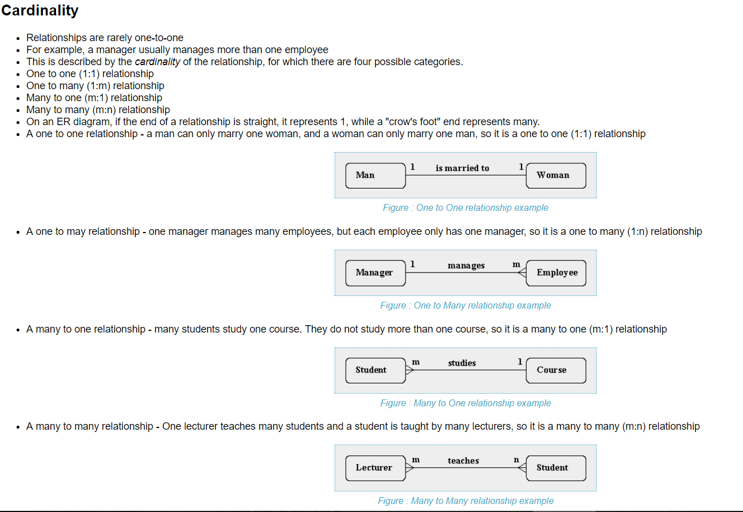
The components and features of an ER diagram

Slide 23
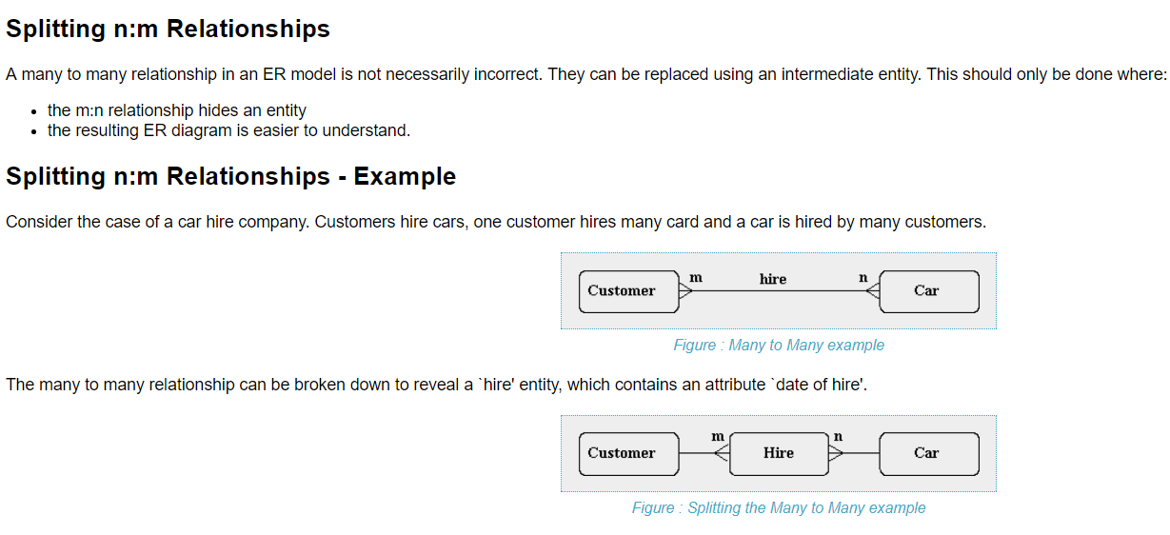
The components and features of an ER diagram

Slide 24
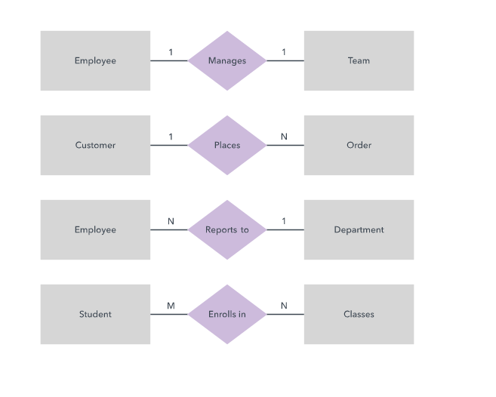
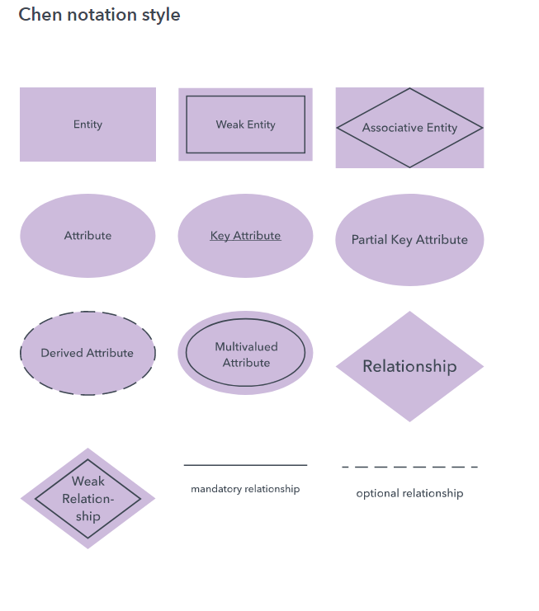
The components and features of an ER diagram

Slide 25
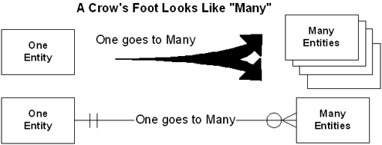
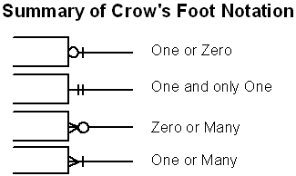
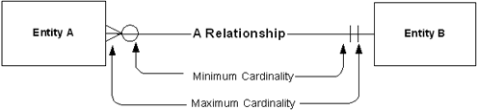
Crows Foot’s Notation
All data modeling approaches attempt to show three things – data entities, the relationships between them and their cardinality.
Cardinality rules define the allowable counts of the relationships – one to many, many to many, etc.
Cardinality specifies two business rules – the minimum number and maximum number of each entity that can participate in the relationship.
Another name for minimum cardinality is “optionality.” It tells us if the relationship is mandatory or optional (i.e., “Can entity A exist without entity B?”).
Maximum cardinality sets the upper bound on the relationship – “for each A, can there be only one B, or many B’s?”

Slide 26
Limitations of ER diagrams and models
Only for relational data: Understand that the purpose is to show relationships. ER diagrams show only that relational structure.
Not for unstructured data: Unless the data is cleanly delineated into different fields, rows or columns, ER diagrams are probably of limited use. The same is true of semi-structured data, because only some of the data will be useful.

Slide 27
How to draw a basic ER diagram
Purpose and scope: Define the purpose and scope of what you’re analyzing or modeling.
Entities: Identify the entities that are involved. When you’re ready, start drawing them in rectangles (or your system’s choice of shape) and labeling them as nouns.
Relationships: Determine how the entities are all related. Draw lines between them to signify the relationships and label them. Some entities may not be related, and that’s fine. In different notation systems, the relationship could be labeled in a diamond, another rectangle or directly on top of the connecting line.
Attributes: Layer in more detail by adding key attributes of entities. Attributes are often shown as ovals.
Cardinality: Show whether the relationship is 1-1, 1-many or many-to-many.

Slide 28
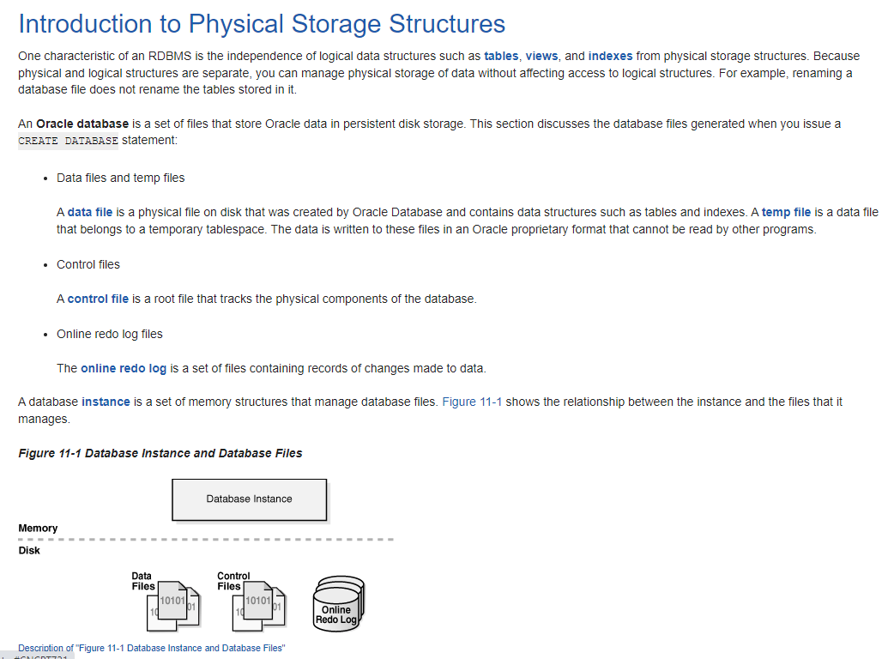

Slide 29
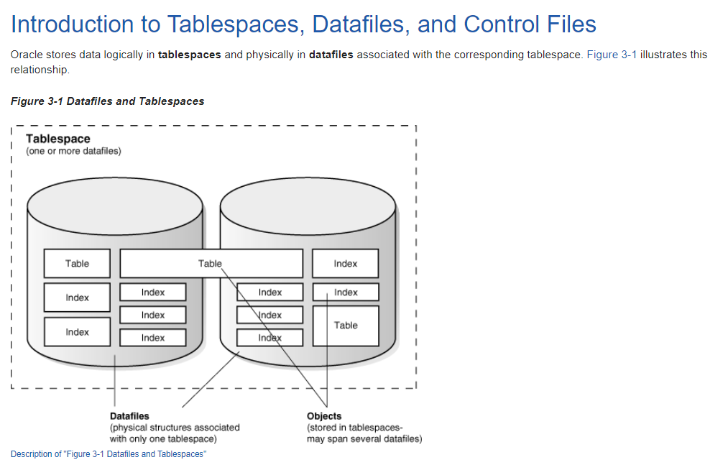

Slide 30
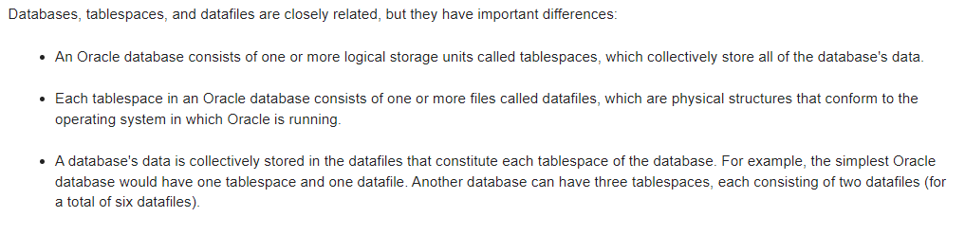
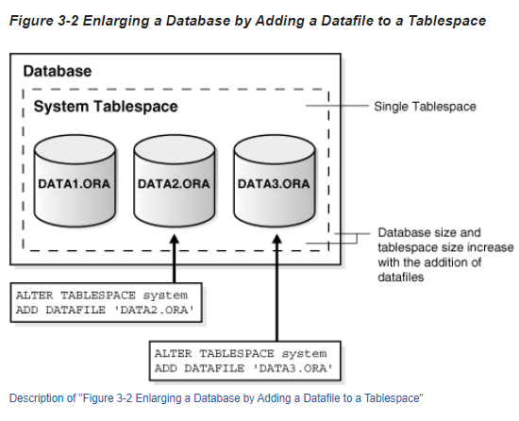
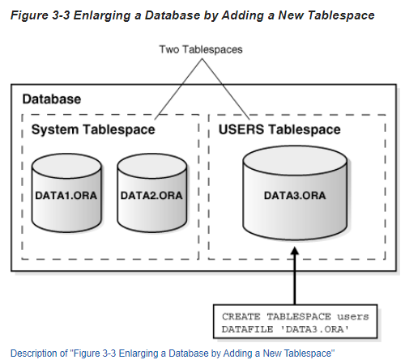

Slide 31
